Slide 1
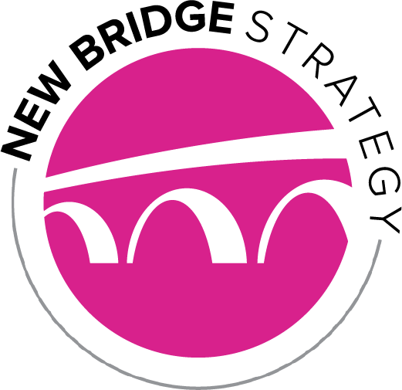
Key Findings from a Survey of Voters throughout Western and Southern Colorado
2019

Slide 2
Methodology
New Bridge Strategy conducted a statistically valid survey of 400 registered voters who are residents of CD3 or Chaffee/Fremont counties.
Interviews were conducted September 20-26, 2019 and were distributed proportionally throughout the region.
Interviews were conducted on cell phones, landlines and via email invitation. The overall margin of error is +4.9% for the overall sample and will vary for sub-groups.

Slide 3
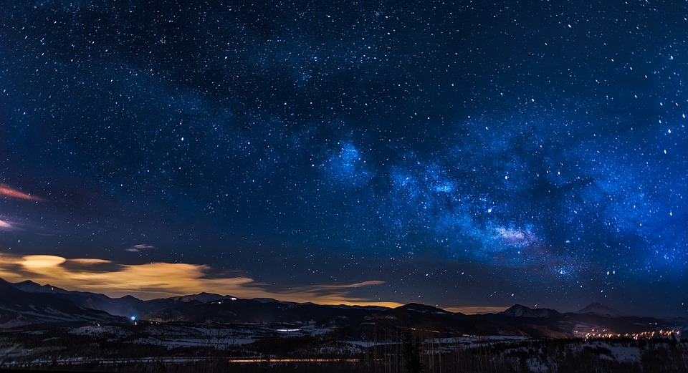
There is a wide consensus that public lands help the Colorado economy.
Helps Our Economy
84%
Hurts Our Economy
6%
Has little impact on our economy
8%
When you think about the presence of public lands, such as national forests, national monuments, or wildlife refuges in Colorado –do you think that having such lands …

Slide 4
Voters across the partisan spectrum say public lands help the economy rather than hurts it by huge margins.
+78% | +77% | +70% | +89%
When you think about the presence of public lands, such as national forests, national monuments, or wildlife refuges in Colorado –do you think that having such lands …

Slide 5
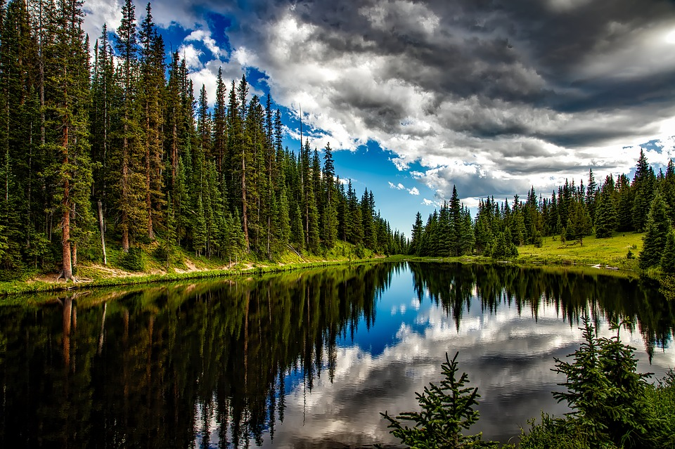
Voters overwhelmingly value the importance of the outdoor economy for the future of Western Colorado.
+86%
68%
Very Important
When you think about the economic future of Western Colorado, how important do you think the outdoor economy will be – meaning people who come to hunt, fish, camp, hike, see wildlife, as well as those who manufacture and sell equipment for those activities?

Slide 6
The outlook is similar regardless if voters hunt or fish.
+86% | +88% | +90% | +88% | +82%
68%
Very
74%
Very
72% Very
73% Very
61% Very
When you think about the economic future of western Colorado, how important do you think the outdoor economy will be – meaning people who come to hunt, fish, camp, hike, see wildlife, as well as those who manufacture and sell equipment for those activities?

Slide 7
Wilderness Areas

Slide 8
A solid majority supports dedicating additional, existing public lands as wilderness areas.
+28%
Just over fifty years ago Congress passed the Wilderness Act, which protected the Maroon Bells and the San Juan Mountains here in Colorado. These areas are designated as wilderness in order to keep that land conserved in its natural state. Wilderness lands can be used for hiking, camping, livestock grazing, horseback riding, wildlife watching, hunting and fishing. However, mining, oil and gas development, logging, and the use of motorized or off-road vehicles and mountain bikes are not allowed on wilderness lands.
Would you support or oppose dedicating additional, existing public lands as wilderness areas here in Colorado?
42%
Strongly Support
22%
Strongly Oppose

Slide 9
Support for designating existing public lands as wilderness areas includes a majority of Republicans.
+28% | +12% | +1% | +87%
Support for Dedicating Additional Existing Public Lands as Wilderness Areas

Slide 10
Respondents who participate in more than one outdoor rec activity are more likely to support designating more wilderness areas.
+28% | +11% | +45% | +33%
Support for Dedicating Additional Existing Public Lands as Wilderness Areas

Slide 11
Support for designating more wilderness extends to ORV users and every other outdoor recreation enthusiast.
+28% | +40% | +33% | +44% | +45% | +4% | +27% | +48%
Support for Dedicating Additional Existing Public Lands as Wilderness Areas

Slide 12
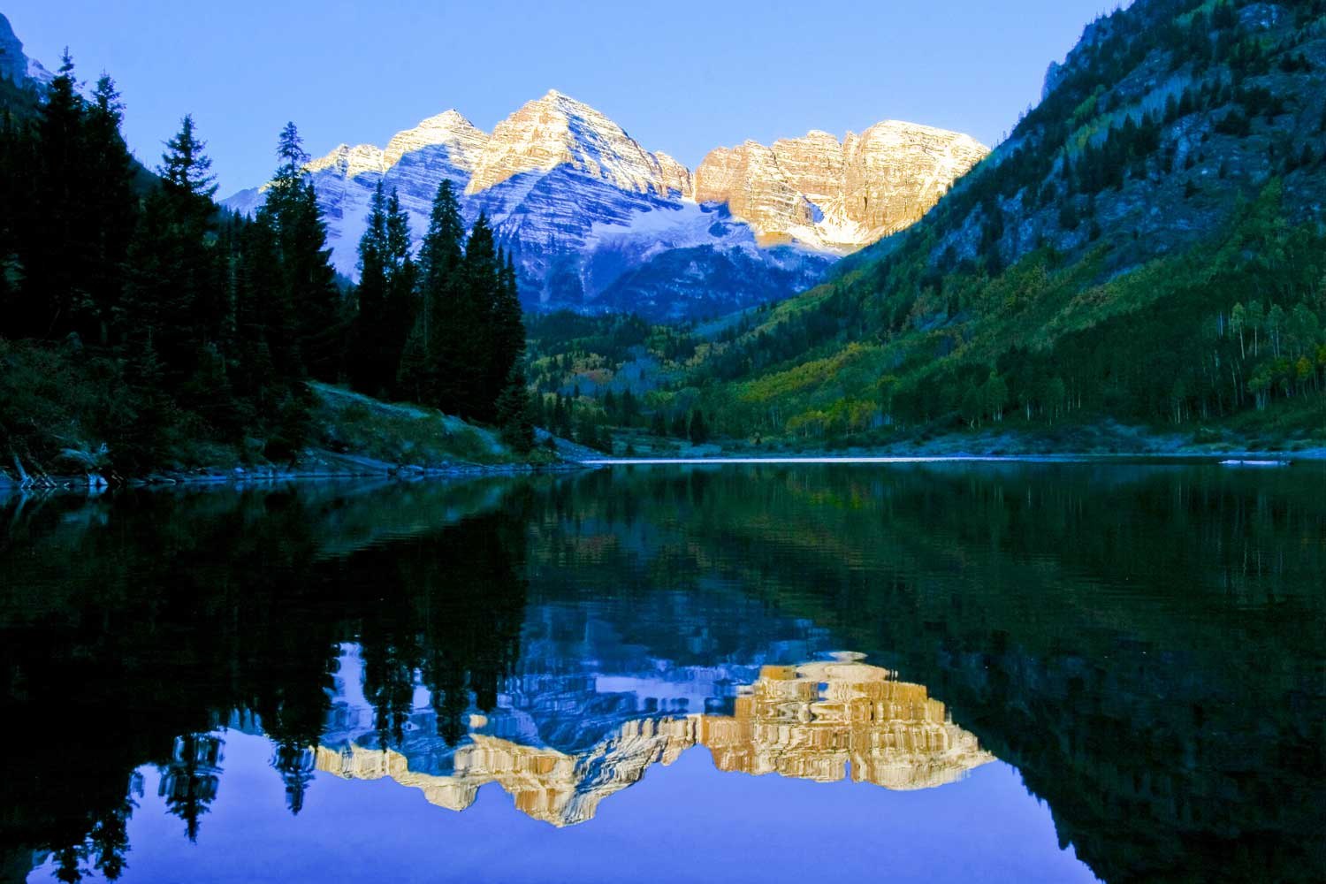
After pointing out that only five percent of Colorado lands are currently wilderness areas, support increases to nearly seven-in-ten for more wilderness.
Those Opposed or Undecided were shown the following prompt and asked again:
Just five percent of Colorado lands are currently dedicated as wilderness areas. Knowing this, would you support or oppose dedicating additional, existing public lands as wilderness areas here in Colorado?
+39%
44%
Strongly Support
19%
Strongly Oppose
Recalculated Support for Dedicating Additional Existing Public Lands as Wilderness Areas

Slide 13
Two-thirds support the CORE Act to designate new wilderness areas in the San Juan Mountains, Continental Divide and protect Thompson Divide.
 | +35%
One proposal would designate new wilderness areas including 14,000-foot peaks in the San Juan Mountains near Telluride and along the Continental Divide around Breckenridge, protect wildlife habitat and ranching in the Thompson Divide area between Carbondale and Paonia from future oil and gas development, and create a national historic landscape commemorating the Army's 10th Mountain Division at Camp Hale.
44%
Strongly Support
19%
Strongly Oppose
Thinking more specifically about some proposals to dedicate additional existing public lands as wilderness areas here in Colorado. Again, keeping in mind that Wilderness lands can be used for hiking, camping, livestock grazing, horseback riding, wildlife watching, hunting and fishing. However, mining, oil and gas development, logging, and the use of motorized or off-road vehicles and mountain bikes are not allowed on wilderness lands. All of these proposals would receive community input. For each one, please indicate if that sounds like something you would support or oppose.

Slide 14
Nearly 7 out of 10 support the proposal that would designate some desert canyons and mesas as wilderness areas.
 | +39%
Most of the existing wilderness areas in Colorado are high mountains and forests, and very little wilderness is designated that includes desert canyons and mesas. One proposal would designate as wilderness lands that include some desert canyons and mesas, such as lands near Mesa Verde National Park, and natural areas along the Arkansas and Dolores Rivers. These amount to less than 10 percent of the public lands in southern and western Colorado.
40%
Strongly Support
18%
Strongly Oppose
Thinking more specifically about some proposals to dedicate additional existing public lands as wilderness areas here in Colorado. Again, keeping in mind that Wilderness lands can be used for hiking, camping, livestock grazing, horseback riding, wildlife watching, hunting and fishing. However, mining, oil and gas development, logging, and the use of motorized or off-road vehicles and mountain bikes are not allowed on wilderness lands. All of these proposals would receive community input. For each one, please indicate if that sounds like something you would support or oppose.

Slide 15
After hearing a description, Western Slope voters want to keep the Wilderness Study Areas as they are now.
In Western Colorado some areas of existing public lands have been protected as Wilderness Study Areas for 40 years, such as the Bookcliffs and the Dolores River Canyon, while Congress decides whether to permanently designate them as wilderness. These public lands are accessible to hunters, anglers, hikers, and others on foot and horse, and allow grazing, but not oil and gas drilling or logging.
There are proposals in Congress that would eliminate protections for a half-dozen wilderness study areas in Colorado. That would open 40,0000 acres to oil and gas drilling, or other industrial development that is currently off-limits. Which would you prefer Congress do –
Keep the Wilderness Study Areas as they are now and retain those protections
71%
Eliminate protections for all of these Wilderness Study Areas and open them for development
26%
Future of Wilderness Study Areas

Slide 16
The Bottom Line

Slide 17
The Bottom Line:
The outdoor economy is viewed as very important to the future of Western Colorado by more than two-thirds. Additionally, an overwhelming number of voters say public lands helps the local economy.
Most voters support dedicating more public lands as wilderness broadly. When we give voters more information and tell them that just 5% of Colorado lands are currently dedicated as wilderness areas, support increases modestly to almost 7-in-10 voters saying they would support dedicating additional existing public lands as wilderness areas.
Specific wilderness proposals also elicit broad support throughout the region.
Wilderness Study Areas also perform similarly well. More than two-thirds (71%) say that Wilderness Study Areas should be kept as they are now and protected. Twenty-six percent want all protections open for development.

Slide 18
Lori Weigel
Principal
lori@newbridgestrategy.com
303.324.7655
Kathryn Hahne
Director
kathryn@newbridgestrategy.com
703.888.9295

